Slide 1

Basic Details of the Team and Problem Statement
Ministry/Organization Name/Student Innovation: Student Innovation
PS Code: 1486
Problem Statement Title: Student Innovation (Boosting the current situation of the Travel and Tourism industry)
Team Name: Illuminati
Team Leader Name: Diya Rawal
Institute Name: B.M.L Munjal University
Theme Name: Travel & Tourism

Slide 2
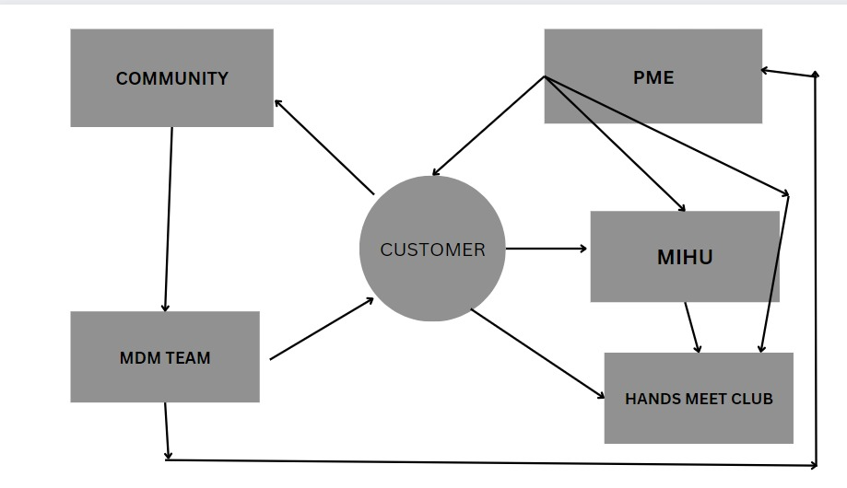
















Idea/Approach Details
Easily Available: A lot of Online portals with the functionality of Hotels Booking, Ticket Booking, Cab Booking, Travel plans, Travel Packages, Offers, etc.
Presently Missing: 1) Layered Authenticity of provided information 2) Lack of Real Assistance 3) Pre and Post Follow ups 4) Personal & Mentally Healthy Touch 5) Events Calendar 6) New Coming Requirements and Sustainable Products and Services 7) Effective Community Forum
Solution: An Eco System with modules like MDM - Master Data Management Team working on point no 1, MIHU - May I Help You speech recognition Chatbot support for points no 2, 3, and 6, PME: Profile Matcher Engine – AI/ML-Based Analysis for point no 3, 5 and 6, Hands Meet Club: for point no 4 and 7.
How to Achieve:
MDM will collect the data of businesses, and people, do the physical review and verification, work on customer feedback/ratings/follow up / review, etc.
Hands Meet Club will have local people who are in guide assistance, homestays, Food and Beverages, Related Business Services, etc., and believe in “Atithi Devo Bhava”.
PME will create a customer profile based on his/her taste, personalized requirements, tentative plans, interests and choices, category, and budget. PME will help the Customer, MIHU, MDM (also Sales and Marketing sub-teams) team to do follow-up, market research, generate offers, plan for the personalized Year Calendar:’CalenderConnect’, and Forecast based on the historical data.
MIHU will help customers with nearby medical assistance, restaurants, interested places, and connections with the Hands Meet club. Real-time data will be fetched via Google APIs. It will also have a “Panic Button” for the Quick Responding team (QRT) for medical, weather forecasting, and crime.
Community support is provided by connecting through ‘Reddit’ which provides feedback and testimonials indirectly. We focus on being the most trusted brand in the tourism industry.
Technology stack :

Slide 3
Idea/Approach Details
Revenue generation via collaborations, agencies, advertising and publicity, and collaborating banks for Acko insurances. We firmly believe in promoting start-ups and diverse Indian culture and traditions thoroughly.
We will have incentives for guides, cab drivers etc.
Use Cases
Dependencies / Show stoppers
Reviews by MDM, Customers, and post forum testimonials are in sync.
People have trust and feel home-like with the Hands Meet Club
sustainability options working
panic button working
chatbot followups are up to date
recommender system with good accuracy
Secure data and transactions, and supply chain(hotels, agencies,transport etc.) transparency due to block chain technologies used.
SSL Certification, penetration,vulnerability testing and ERNET Domain for site for authenticity and security
Marketing and Getting Traffic on our Unique Product
Making a Smart, Intelligent, and Social MDM Team with Capabilities of doing Review, verification, Generating Data, Forecasting, Making Offers, and Personal Touch Follow-ups
Network Creation for Hands Meet Club
Hand Meet Club Members Verification, Interviews, and Psychometric tests conducted, along with general channel verifications via KYC, AdharPan, etc.
MIHU Integration with Google APIs for user-friendly services and real-time data.

Slide 4
Team Member Details
Team Leader Name: Diya Rawal
Branch: BTech Stream: CSE Year : II
Team Member 1 Name: Ridit Jain
Branch: BTech Stream: CSE Year : III
Team Member 2 Name: Akshat Manohar
Branch: BTech Stream: CSE Year : III
Team Member 3 Name: M.Mahaansh Reddy
Branch: BTech Stream: CSE Year: III
Team Member 4 Name: Vardaan
Branch: BTech Stream: CSE Year : III
Team Member 5 Name: Ishika Kochhar
Branch: BTech Stream: CSE Year : II
Team Mentor 1 Name: Mr. Dinesh Singh
Category (Academic/Industry): IT- Industry Expertise: DBMS and Solution Design Domain Experience:15+ years

